Slide 1
DATA, LINKAGE & BASELINE PROFILE
Feasibility of Linking Maternal Health Data Without Unique Identifiers in Uganda: A case study of ~22K ANC appointments.
Josiline Chemutai
Cecina Babich Morrow
Adellah Ainembabazi
Alice Nassanga
Isaac Kasango
Naveen Bhargav
Aaron
Christopher Baleke
Mayuge HC IV · Buluba Hospital · 2023–2024
MIHRI Data Programme

Slide 2
VARIABLES IN THE DATA
Introduction
Maternal health data (ANC, delivery, postnatal) are collected in separate systems, leading to fragmented and inconsistent records
Lack of unique identifiers limits tracking of women across the care continuum
Probabilistic record linkage can connect records using variables (e.g., name, age, residence, dates) but has not been well explored in Ugandan settings
Why this matters:
Enables assessment of continuity of care (ANC → delivery) and identification of service gaps
Provides a low-cost, scalable alternative in resource-limited settings
Allows creation of retrospective and prospective cohorts from routine data
Supports longitudinal maternal health research without costly primary data collection
Informs health system improvement, data integration (EHRs/TREs), and national policy

Slide 3
INTRODUCTION TO THE DATA
The dataset
~22k
2
2023–24
100+
ANC visit records
facilities
calendar years
variables per record
FACILITIES
Mayuge HC IV
Buluba Hospital
Health Centre IV: primary referral, high-volume ANC clinic
Faith-based hospital: broader services, longer paper records
The challenge
Each row is one visit, but we lack unique patient identifiers. Before any analysis, we need to know who is who.

Slide 4








VARIABLES IN THE DATA
What every visit record contains
Identifiers
Demographics
client number, first/last name, contact, facility, visit date
age, district, subcounty, parish, village, category (new/return)
Obstetric history
Anthropometry & vitals
gravida, parity, gestational age, ANC1 timing, ANC visit number
weight, height, MUAC, blood pressure (systolic & diastolic)
Laboratory
HIV / PMTCT
hemoglobin levels, blood group, syphilis, hepatitis, urine
EMTCT codes, ART, CD4, infant feeding counselling
Care actions
Diagnoses & outcomes
tetanus, IPT dose, freellin (ITN), mebendazole, ironacid
diagnoses, complications, referrals

Slide 5
VARIABLE DEFINITIONS
Two engineered variables built for linkage
We derived two new variables from the raw fields to help with potential linkage issues:
est_mother_birth_year
numeric_delivery_date
Estimated birth year of the mother
Expected delivery date (numeric)
year(visit_date) − ageyrs
make_date(year = expected_yrdlvry,
month = expected_mmdlvry,
day = delvry_day)
OR
visit_date + weeks(40) - weeks(anc_gestationalage)
WHY
WHY
The mother's age could increase between visits but the year she was born would not. Comparing records on mother's birth year means visits by the same mother a year apart should still align. Note: we may still have discrepancies due to birthdate timings.
Built from expected delivery day + month + year when present, or from gestational age otherwise. Converted to a number so it can be compared with a tolerance.

Slide 6
LINKAGE VARIABLES
Which variables we use to link records — and how
EXACT MATCH
STRING DISTANCE
NUMERIC DISTANCE
must be identical
tolerates spelling errors
small gap = same
client_no
first_name
est_mother_birth_year
ANC register number
Given name
Visit year − age
last_name
anc_parity
Family name
Previous live births
client_contact
anc_parity_2
Mobile number
Previous pregnancies ≥ 24 weeks stillbirth or miscarriage
location_combined
Parish + village
anc_gravida
Previous pregnancies
anc_height
Height (cm)
delivery_date
Expected delivery
Each variable contributes one piece of evidence; the model combines them into a single probability of matching per pair.

Slide 7
THE METHOD
How the linkage is done
For every pair of records, the model asks: how likely is it that these two visits belong to the same woman?
1
2
3
4
Compare fields
Score the pair
Cluster into patients
Validate and iterate
Each variable is compared by the rule we set: exact, string-similarity, or numeric-distance matching.
The fastLink R package combines field-level evidence into a single probability of a match, weighting informative agreements more.
Pairs above the probability threshold are linked. Connected records are grouped into patient IDs.
We spot-check the results using real cases and adjust our methodology if results are not credible.

Slide 8
PART 01
Buluba Hospital: Three attempts at linkage
Each attempt: our methodology, our results, our learnings

Slide 9
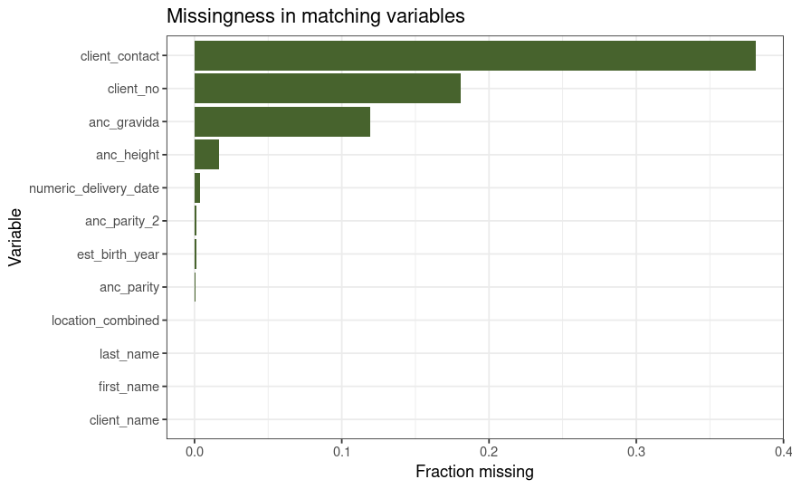
INTRODUCTION TO THE DATA
Initial dataset: Buluba Hospital
Starting with a more manageable dataset
We started working with the data from a single hospital to identify data issues on a manageable number of records.
38%
Client contacts missing
3,839
18%
ANC visit records
Client number missing
Proportion of missingness for matching-relevant variables

Slide 10
ATTEMPT 1
First attempt — generous threshold, all variables included
Start broad: include every variable and accept any pair with a match probability over 85%.
WHAT WE DID
WHAT WE GOT
Used all 11 matching variables: client_no, first name, last name, contact, location, est_birth_year, parity, parity_2, gravida, height, delivery date
UNIQUE PATIENTS
LARGEST CLUSTER
497
2,724
Set match threshold to 85% (a relatively permissive cutoff)
Too lenient — clearly broken
Built patient IDs by grouping all linked record-pairs
A single ‘patient’ with 2,724 visits is impossible. Far too many distinct women have been lumped together.

Slide 11
ATTEMPT 2
Second attempt — same variables, stricter threshold
We increased the threshold for a match to 97% probability in an attempt to break up the giant cluster.
WHAT WE DID
WHAT WE GOT
Kept all 11 matching variables — no changes to the variable set
UNIQUE PATIENTS
LARGEST CLUSTER
Raised the match threshold from 85% to 97%
1,191
534
Re-ran fastLink and re-clustered the resulting pairs
Better — but chains persist
More patients identified, biggest cluster has shrunk by 80%. But 534 visits in one ‘patient’ is still impossible: the threshold alone is not enough.

Slide 12
DIAGNOSIS
Why a giant cluster forms: ‘friend of a friend’
Matching process:
Pairwise matches get grouped together
Clusters of records that are linked share a patient ID.
A
B
C
A ↔ B match
B ↔ C match
(parity, gravida same)
(height same)
Patient A's visit
Patient B's visit
Patient C's visit
A ↔ C never match directly but get grouped anyway
‘Transitive closure’: Common values (e.g. parity = 2 and gravida = 3), or unreliable values with limited ranges (e.g. height) chain unrelated women together through intermediates. Tightening the threshold alone will not solve this.

Slide 13
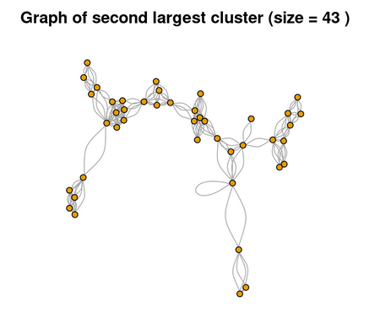
DIAGNOSIS
What the chains look like inside a cluster
Each dot is one ANC visit; each line is a match. A real cluster of repeat visits should be tightly interconnected.
THE FIX
Long chains form on weak evidence: matches on variables many women share. The fix is not a higher threshold but a smaller, more distinctive variable set.
DROP
anc_parity, anc_parity_2, anc_gravida, anc_height
Second-largest cluster (43 records, threshold 0.97)

Slide 14
ATTEMPT 3
Third attempt — stricter threshold and fewer variables
Keep the 97% threshold; drop four variables with common values or messy data.
WHAT WE DID
WHAT WE GOT
Kept threshold at 0.97
UNIQUE PATIENTS
LARGEST CLUSTER
1,759
10
Dropped anc_parity, anc_parity_2, anc_gravida, anc_height
Retained client_no, names, contact, location, est_birth_year, numeric_delivery_date — the seven most individuating fields
Plausible — adopted
Patient count increased by 550+ and the largest cluster is now 10 visits — clinically realistic for a high-volume ANC client over two years.

Slide 15
VALIDATION
Validation — client 189 splits cleanly into 4 patients
The same client number (189) was used by multiple women. The final model assigns four separate patient IDs , matching the manual reading of the records.
PATIENT #387
PATIENT #341
PATIENT #201
PATIENT #41
Patient A
Patient B
Patient C
Patient D
1 visit
5 visits
1 visit
3 visits
Distinct name and earliest delivery date by almost 1 year
Slight spelling drift in names and contact number correctly merged
Distinct name
Younger patient with matching name and consistent contact number (when present).
✓ Four distinct women, correctly separated

Slide 16
VALIDATION
Validation — are we now too strict?
We do not want to overcorrect and separate appointments that should be identified as belonging to the same patient.
PATIENT #387
PATIENT #341
PATIENT #201
PATIENT #41
Assigned ID | Visit date | Client Number | Name | Contact | Estimated birth year | Height & parity | Delivery date | Parish & village
Patient #1379 | 2024-11-21 | 139 |  | [missing] |  |  |  | Lukone, Lukone
Patient #1711 | 2024-12-19 | 329 |  |  |  |  |  | Katonte, Katonte
Off by 1 letter
Matching
Matching
25 days apart
✗ Likely incorrectly separating appointments belonging to the same person

Slide 17
SUMMARY
The journey at a glance
ATTEMPT 1
ATTEMPT 2
ATTEMPT 3
All variables · threshold 0.85
All variables · threshold 0.97
Distinctive variables · threshold 0.97
UNIQUE PATIENTS
UNIQUE PATIENTS
UNIQUE PATIENTS
497
1,191
1,759
BIGGEST CLUSTER
BIGGEST CLUSTER
BIGGEST CLUSTER
2,724
534
10
Too lenient
Improved — chains remain
Plausible — adopted

Slide 18
PART 02
Two hospitals: total linkage attempt
Linkage on Mayuge HC IV and Bulubu Hospital

Slide 19
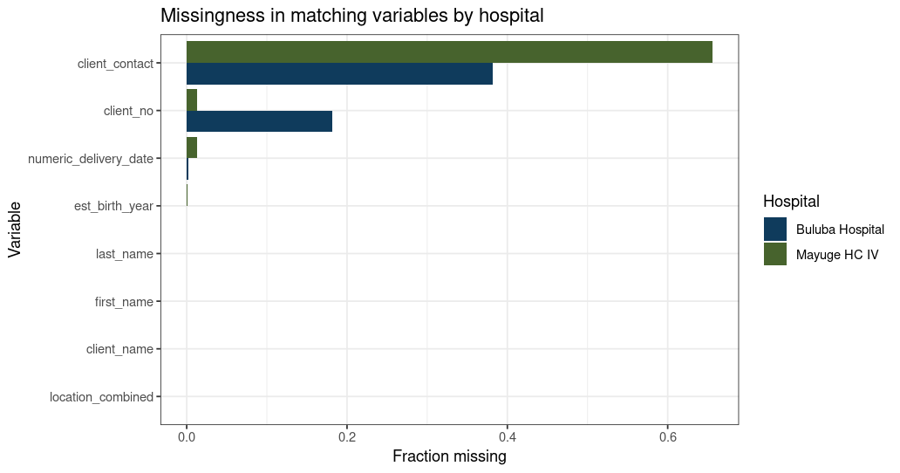
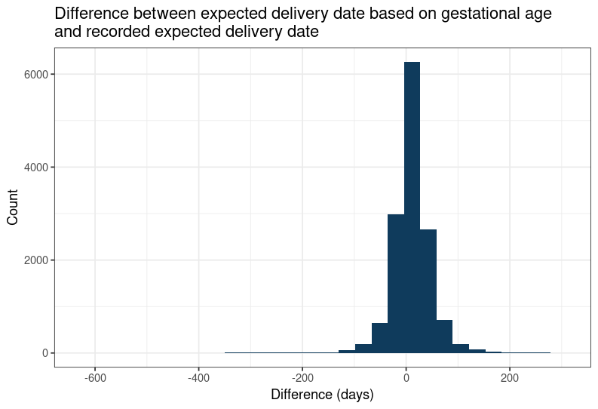
INTRODUCTION TO THE DATA
Total dataset: Mayuge HC IV & Buluba Hospital
Complete dataset
We now have 22,037 visit records: 3,839 from Buluba and 18,168 from Mayuge, a 5x increase in number of visits from our first linkage attempts.
Significant discrepancy in the entered expected delivery date and the expected delivery date based on gestational age
Mayuge HC IV has high missingness in client contact (66%), while Buluba has higher missingness in client number (18%).

Slide 20
ATTEMPT 1
First attempt — fewer variables
Including the variables that gave us the best success on the Buluba data, using the 85% match threshold.
WHAT WE DID
WHAT WE GOT
Used 7 matching variables: client_no, names, contact, location, est_birth_year, numeric_delivery_date
UNIQUE PATIENTS
LARGEST CLUSTER
9,497
11
Set match threshold to 0.85
Built patient IDs by grouping all linked record-pairs (graph components)
Plausible
Plausible value for a maximum number of appointments for a single patient

Slide 21
VALIDATION
Validation
With the new, larger dataset, client number 189 now splits into 8 patients, matching manual review:
But we have the same problem with the individual with 2 appointments still being misidentified as 2 different patients:
BULUBA HOSPITAL
PATIENT #387
4 patients
PATIENT #341
PATIENT #201
PATIENT #41
Patient A: 1 visit
Patient B: 5 visits
Patient C: 1 visit
Patient D: 3 visits
Assigned ID | Client Number | Name | Estimated birth year | Height & parity | Delivery date | Parish & village
Patient #8733 | 139 |  |  |  |  | Lukone, Lukone
Patient #7064 | 329 |  |  |  |  | Katonte, Katonte
MAYUGE HC IV
Off by 1
Match
Match
25 days apart
4 patients
Patient E: 1 visit
Patient F: 2 visits
Patient G: 1 visit
Patient H: 4 visits
✓ Eight distinct women, correctly separated
✗ Likely incorrectly separating appointments belonging to the same person

Slide 22
PART 03
Baseline descriptive statistics
Who are the 9,497 women we now have in the cohort?

Slide 23
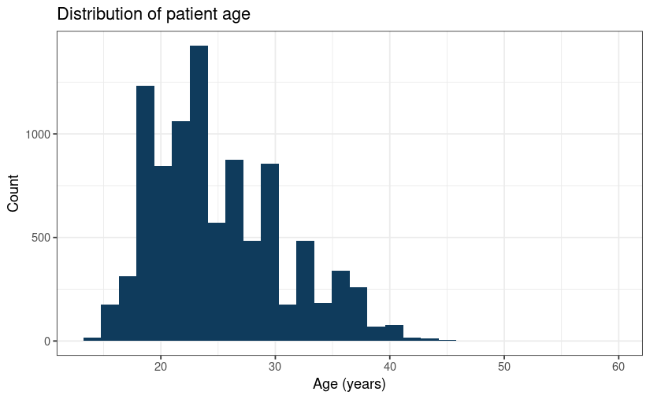
DEMOGRAPHICS
✎ ILLUSTRATIVE — VERIFY
Maternal age
MEDIAN AGE
IQR
24
20–29
years
years
MEAN (SD)
RANGE
25.0
14–59
(5.9)
years
COMPLETENESS OF AGE VARIABLE
>99.9%
complete
Distribution of age at time of appointment

Slide 24
GEOGRAPHY
Where the women come from
84%
14%
49
live in Mayuge district
districts represented
lack a district at all
Top 5:
Kasugu: 826 patients
Lugolole: 588 patients
Buwolya: 518 patients
Ikulwe: 416 patients
Maina: 401 patients
Top 5:
Jinja: 41 patients
Iganga: 30 patients
Bugweri: 18 patients
Luuka: 18 patients
Kampala: 17 patients
COMMON PARISHES OF MAYUGE
OTHER DISTRICTS REPRESENTED

Slide 25
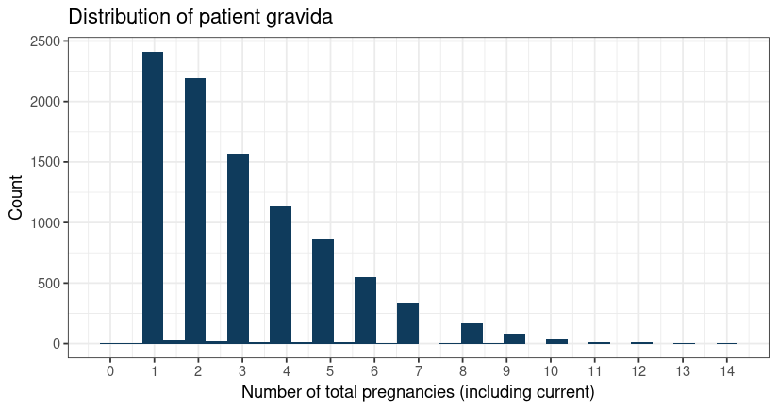
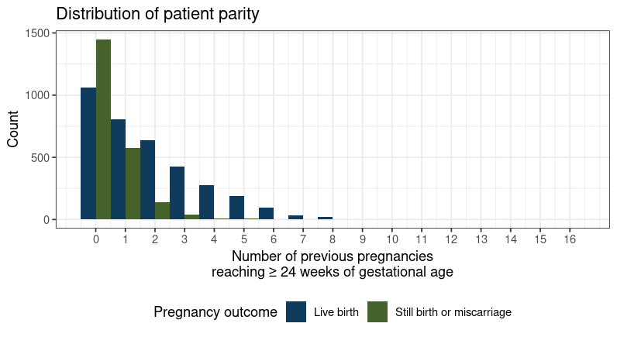
PREGNANCY HISTORY
Obstetric profile
MEDIAN GRAVIDA
PRIMIGRAVIDA
MEDIAN PARITY
3
25%
1+0
(IQR 2–5)
first pregnancy
(63% missing data)

Slide 26
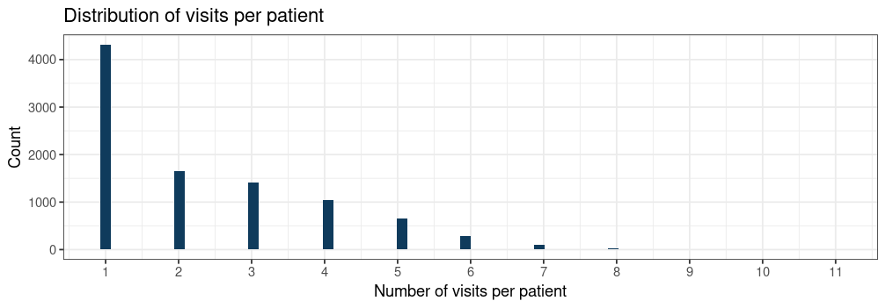
ANC ENGAGEMENT
How many times each woman attended
MEDIAN VISITS
SINGLE-VISIT
ANC4+
MAX OBSERVED
2
45%
22%
11
(IQR 1–3)
attended once
completed 4+ visits
visits in window

Slide 27
FROM VISITS TO PATIENTS — AND ONWARDS
9,497 women now
identifiable across all 22,037 visits.
With the linkage in hand, we can now link forward to delivery and postnatal datasets, investigate maternal and child outcomes, and build the first AI-ready perinatal cohort from this catchment.
Questions and discussion

